Slide 1
GridLAB-D: A Unique Tool to Design a Smarter Grid
Jason Fuller
Electricity Infrastructure Technical Group Manager
Pacific Northwest National Laboratory

Slide 2


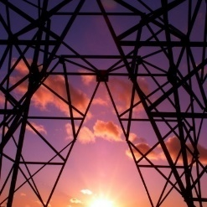


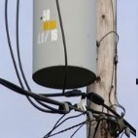
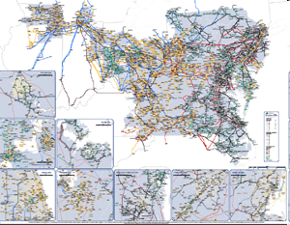
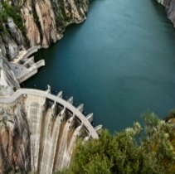
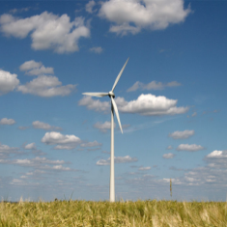
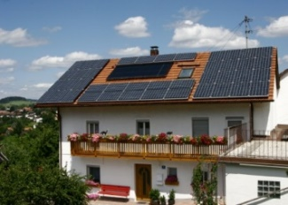
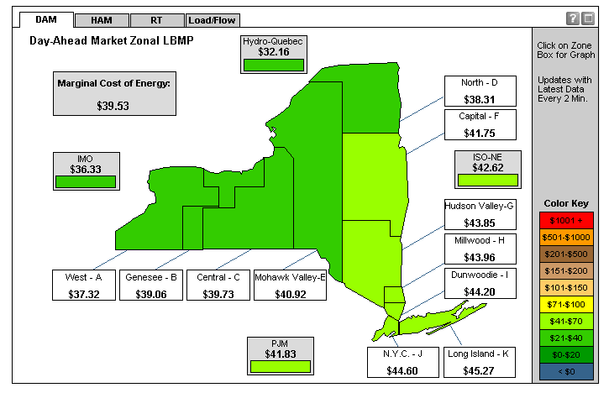





GridLAB-D: A Unique Tool to Design a Smarter Grid
Unifies models of the key elements of a smart grid:
Loads & DERs
Power Systems
DSO Markets
Over 80,000 downloads in over 150 countries
Smart grid analyses
field projects
technologies
control strategies
cost/benefits
Time scale: ms to years
Open source (BSD-style)
Contributions from
government
industry
academia
Vendors can add or extract own modules
Open-source, time-series simulation of an operating smart grid, from the substation to individual end-use loads & distributed energy resources, in unprecedented detail
Simultaneously solves
1) power flow 2) control systems
3) retail markets 4) electromechanical dynamics
5) end-use load behavior in tens of thousands of buildings and devices

Slide 3
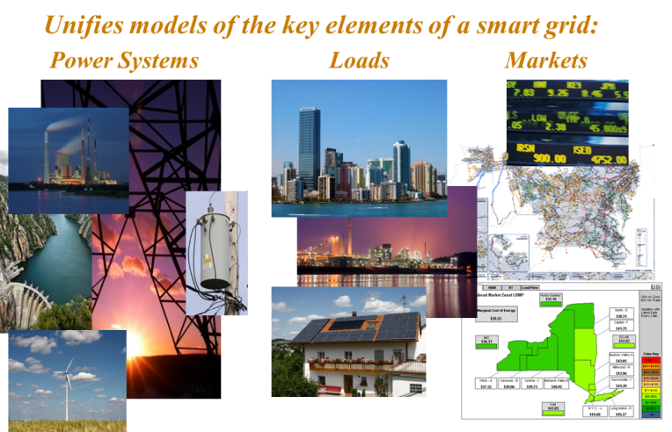
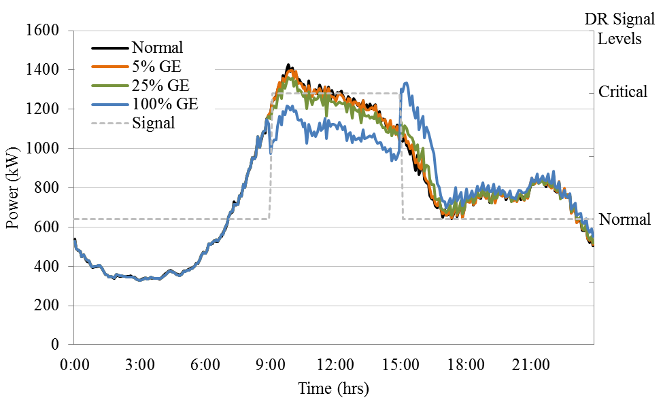
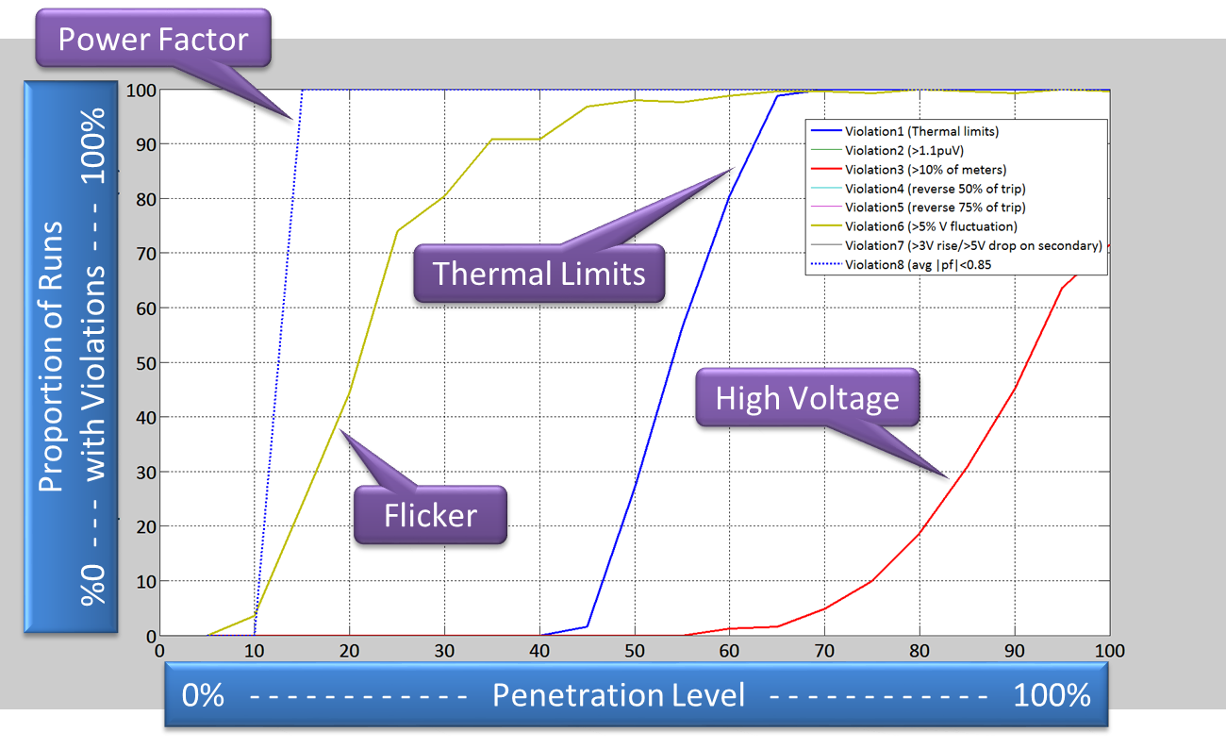
GridLAB-D Capabilities
Performs time-series simulations
Seasonal effects (days to years)
Midterm dynamic behavior (secs to hrs)
System dynamics (milliseconds)
Simulates control system interactions
Device- and system-level controls
Market interactions
Typical Use Cases
Interconnection of distributed generation and storage
New and innovative retail market structures (e.g., DSOs)
Evaluation of demand response and energy efficiency
Volt-VAr optimization and conservation voltage reduction design
Sectionalizing, reconfiguration, automation, and restoration
Microgrids and resiliency

Slide 4
Definitions for this presentation
What does agent-based mean?
The changing states of individual devices/agents are modeled independently
The interactions between individuals are captured
The environment in which these evolve together is a combination of all these interactions
Dynamic simulation can include time series (timestep greater than 1 second)
For this presentation, quasi-steady state simulation is defined as having a timestep at 1 second or greater
Sequence of powerflow states coupling other behaviors, such as multi-state load models
Focused typically on 1-minute or longer range – behavioral and diurnal dynamics
For this presentation, dynamic simulation is defined as having a timestep less than 1 second
Sequence of powerflow states coupling differential equations
Focused mainly on 0.5 ms to 50 ms range – electromechanical dynamics

Slide 5
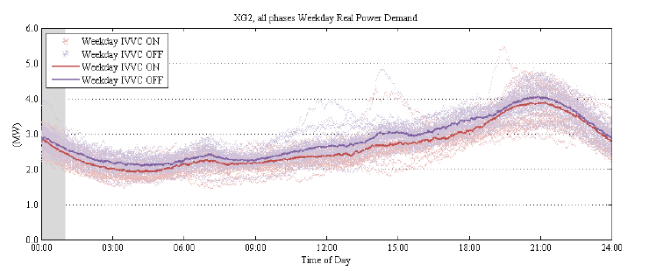
GridLAB-D Studies (General)
American Reinvestment and Recovery Act (ARRA) Smart Grid Investment Grant (SGIG) evaluation
Taxonomy-feeder based
Several technologies examined
Conservation Voltage Reduction/Volt-Var Control evaluations
Validated against actual system data
Developed methods for estimating CVR/VVO impacts
Business case for scalable demand response
Evaluated cost reductions and help refine the implementation
Evaluate solar carrying capacity and installation impacts
Examined feeder-level impacts of solar deployments
Volt-Var Control evaluation
Compare the cost-to-benefits ratio of household types or green- vs. brown-field growth.

Slide 6
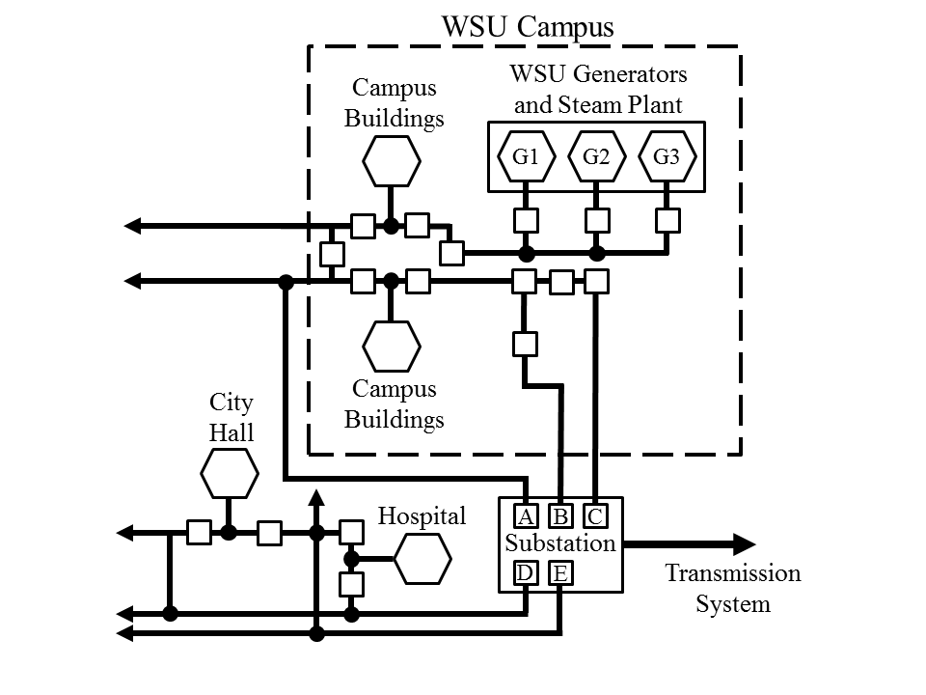
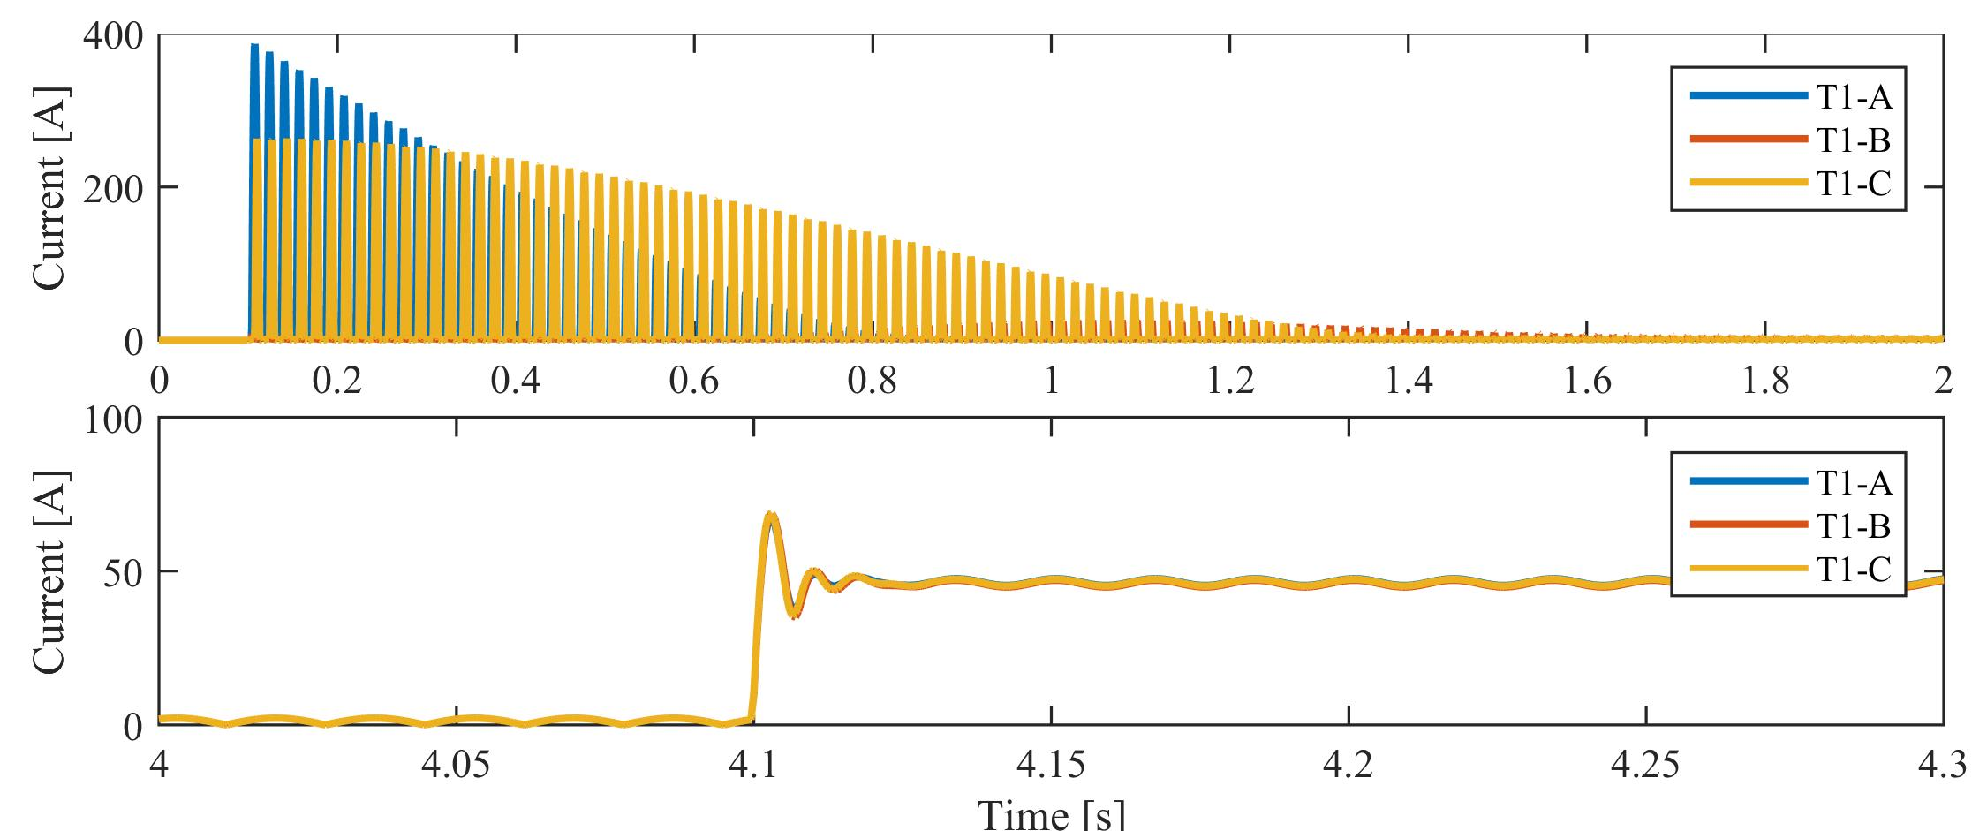
Dynamic Simulation Usages
Transients on distribution systems
Tripping of IEEE 1547A devices
Grid Friendly Appliance™ impacts
Microgrid Analysis – Resiliency
Inrush and line charging
Overhead and underground lines being energized
Transformer saturation
Motor starting surges
Frequency and voltage impacts
Acceptable ranges
Secondary tripping of items
Evaluate methods for improving resiliency
WSU example for evaluating “Microgrids as a Resiliency Resource”
Transformer current in 8500-node system
during connection of primary transformer

Slide 7
How does GridLAB-D Work?

Slide 8
GridLAB-D Architecture
Core responsibilities
Integrates models
Manages memory & CPUs
Coordinates time
Handles stochastic requirements
Synchronizes updates (ranks)
Coordinates variable sharing
Manages convergence
Tracks numerical stability
Measures system performance
Debugs module behavior
Markets
GridLAB
Core
Events
Communications
Behavior
Buildings
Telemetry
Weather
Analysis
Power System
Controls
Protection

Slide 9
Defining the System
Module
Collects classes that are related
Groups common parameters and solvers
May be proprietary or open-source
Class
Defines similar objects
Properties are the same for all objects, but set parametrically
Static classes are pre-compiled in distribution
Object
Instances of classes
Used to define the different agents in the system
Each property is assigned an individualized value

Slide 10
Example Instantiation of an Object
Set a house with default values
module residential; // module declaration
object house { // instantiation of an object of class house
name MyHouse;
}
Set a house with custom values
module residential; // module declaration
#include "CA-Los_angeles.glm“ // define weather conditions
object house {
floor_area random.normal(1500,300) sf; // set properties
heating_setpoint 70.0 degF;
cooling_setpoint 76.0 degF;
thermostat_deadband 1.0 degF;
}

Slide 11
Running a Simulation

Slide 12
Creating a GridLAB-D Model (GLM) file
clock {
timezone PST+8PDT;
starttime '2000-01-01 0:00:00'; //defines a 6-month
stoptime '2000-07-01 0:00:00'; //simulation length
}
module powerflow;
module residential;
module tape;
object triplex_meter {
phases AS;
nominal_voltage 120 V;
name my_meter1;
}
object house {
parent my_meter1;
name my_house1;
floor_area random.normal(1500,300) sf;
heating_setpoint 70.0 degF;
}
object recorder{
parent my_house1;
property air_temperature,heating_setpoint;
file theat_record.csv;
interval 60 s;
}
Instantiates the model to be loaded into the solver
Defines the initial conditions of each agent
Defines the relationships between the agents
Sets the run-time
Defines which parameters to observe
Text-based!

Slide 13
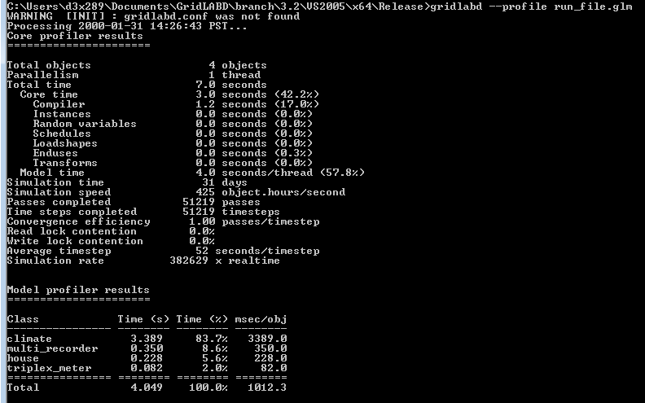
Running the Model
To execute, you get to use a command prompt!! (and the equivalent in Linux and MacOS)

Slide 14
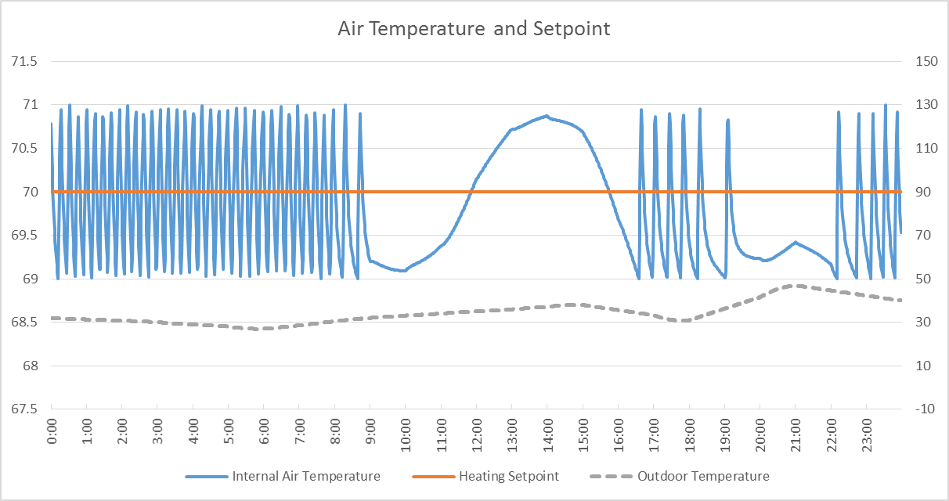
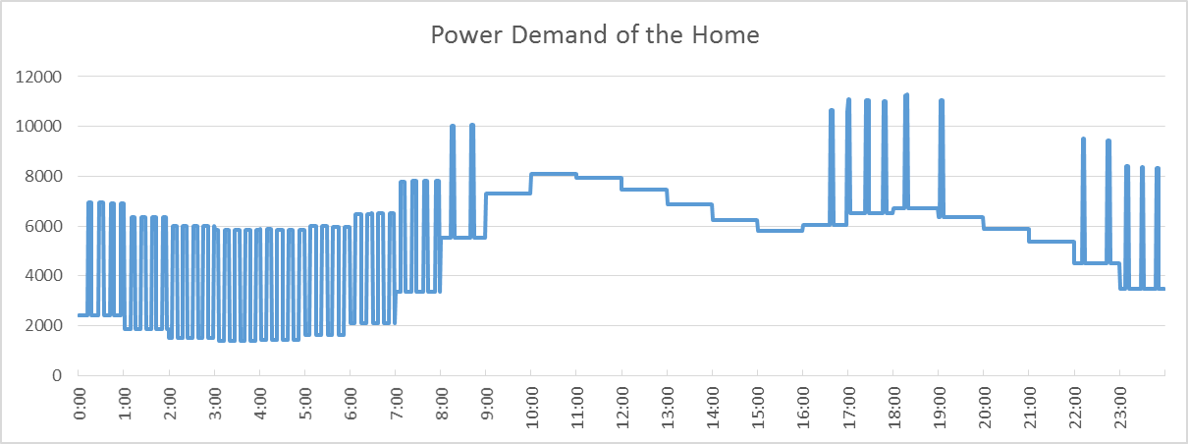
Outputs
Must be defined
Does NOT automatically record every variable at every timestep
Typically CSVs
Most often a time series of data channels
Some aggregation and reporting
Can also be pushed to databases (or external connections)
XML “dump” can be used to pull the entire system state simultaneously
Collectors can aggregate similar properties from across many agents
Note: I added a couple metering points and added a climate object.

Slide 15
Input Parameters
Fixed, static parameters
Randomized over a population
Driven by a time-series input
Player
Shape
Schedule
External Source
Once properly randomized (and diversified), we can build a load shape most of us are more familiar with…

Slide 16
Example of Adding Agents
1 Home
100 Homes
8 Homes
Loadshape

Slide 17
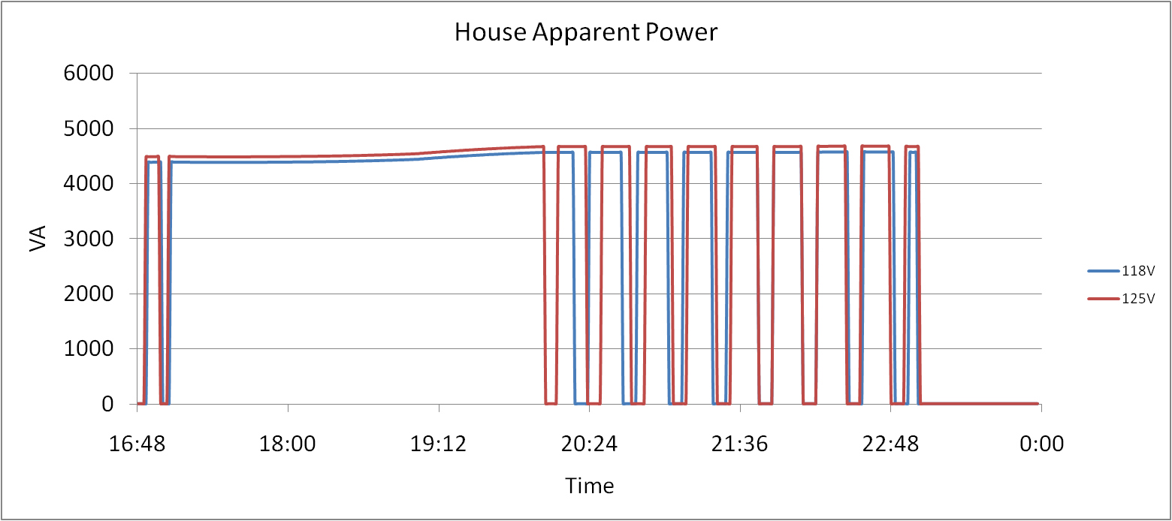
Why do we want to model as agents?
Simple examples of interactions
Resistive Heating
Heat Pump HVACs
The interactions of the different agents (and particularly their controls) can often reveal unforeseen behaviors

Slide 18
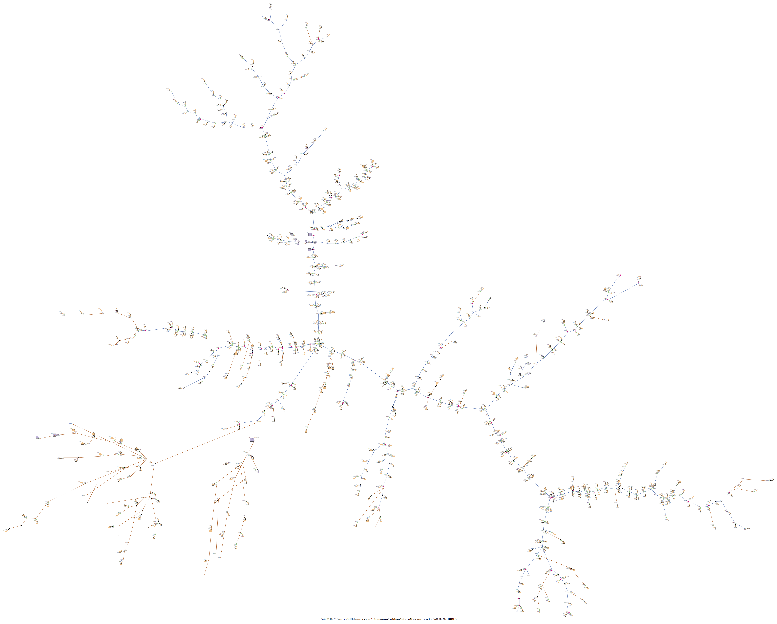
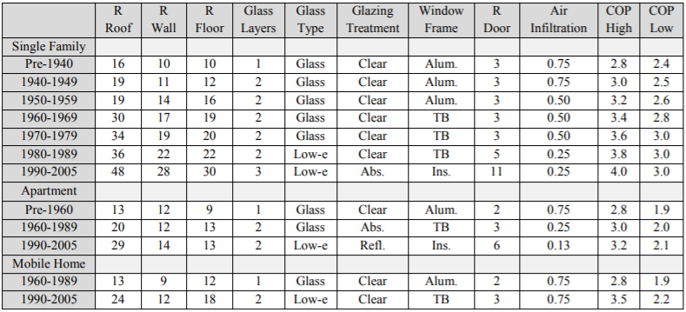
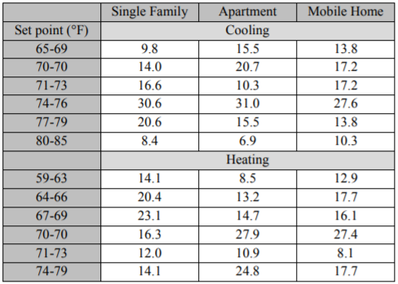
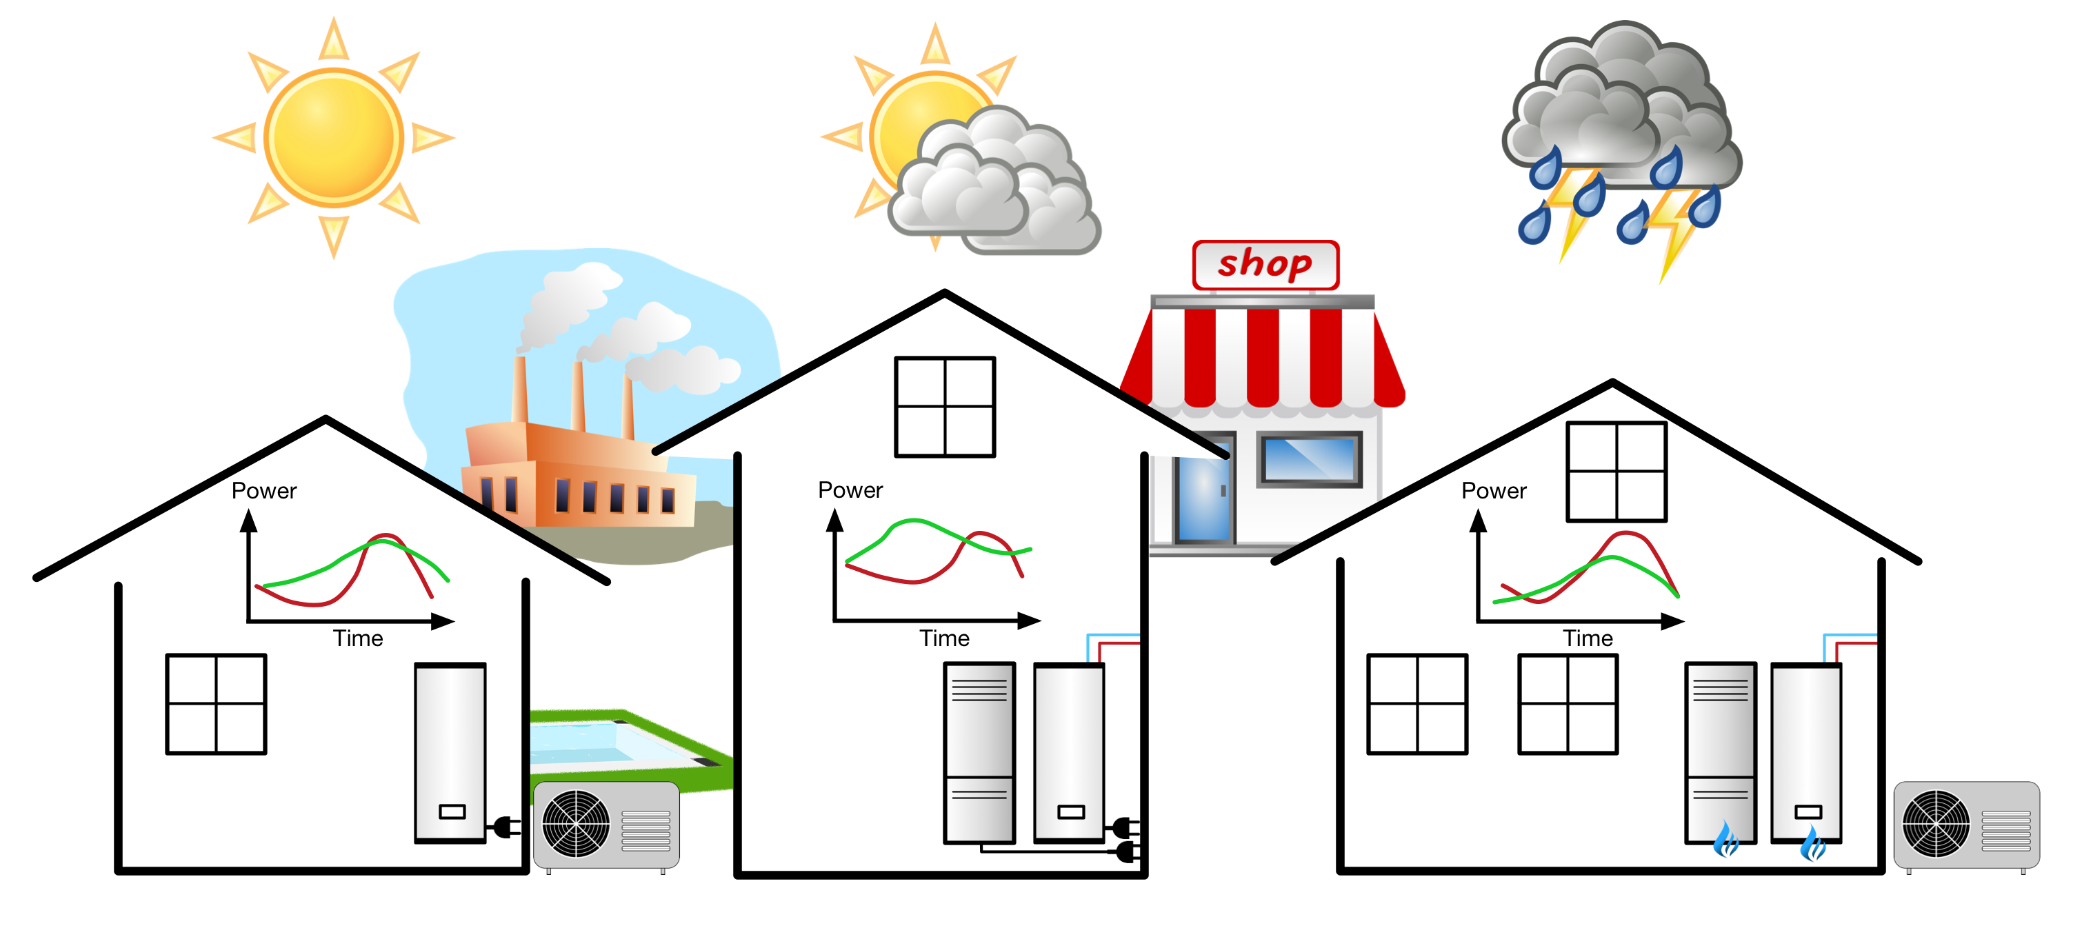
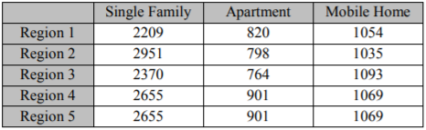
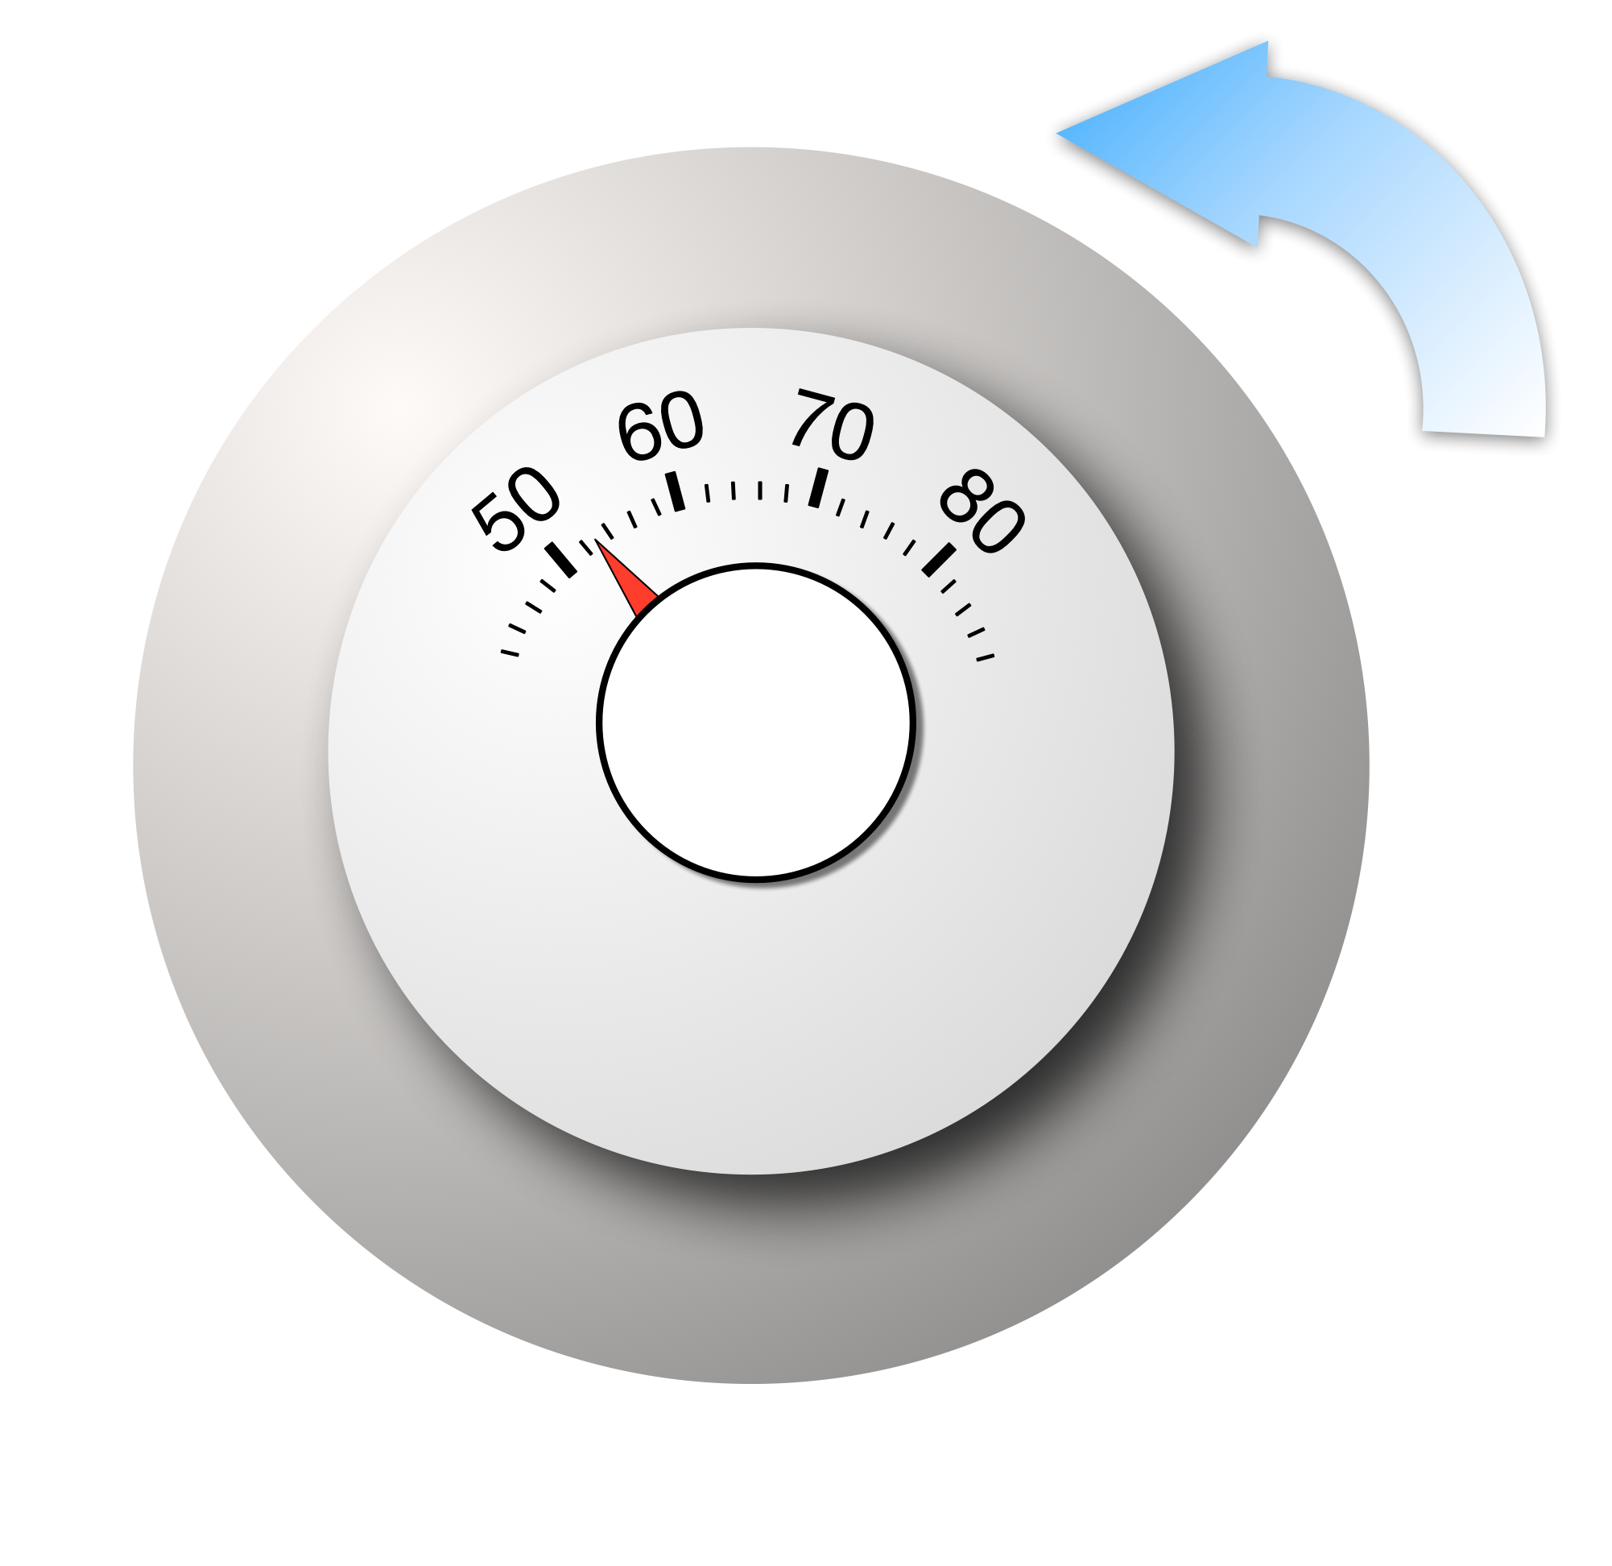
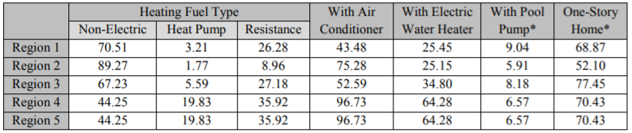
Getting the Diversity can be Challenging
clock {
timezone PST+8PDT;
starttime '2000-01-01 0:00:00';
stoptime '2000-07-01 0:00:00';
}
module powerflow;
module residential;
module tape;
object triplex_meter {
phases AS;
nominal_voltage 120 V;
name my_meter1;
}
object house {
parent my_meter1;
name my_house1;
floor_area random.normal(1500,300);
heating_setpoint 70.0 degF;
}
object recorder{
parent my_house1;
property air_temperature;
file theat_record.csv;
interval 60 s;
}

Slide 19
We try to help…
Model creation, conversion, and execution scripts are available
A number are available on GridLAB-D repository (primarily Python)
Some are located in other open-source tools (e.g., TESP, OMF, etc.)
“Prototypical” and IEEE circuits are available
24 prototypical circuits are converted utility circuits that are regionalized to North America
These can act as starting points, rather than starting from scratch

Slide 20
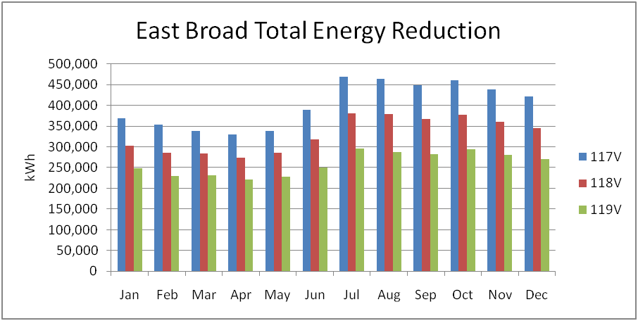
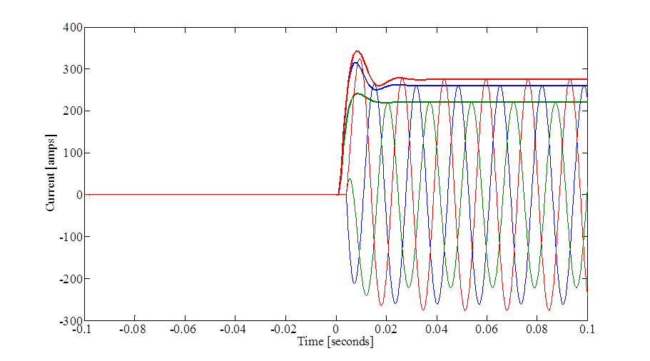
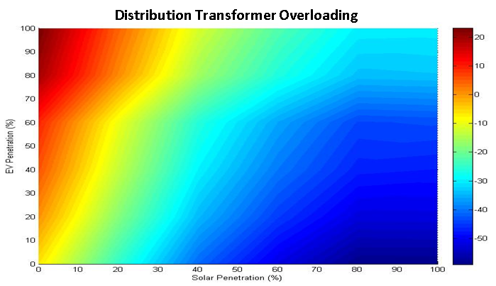
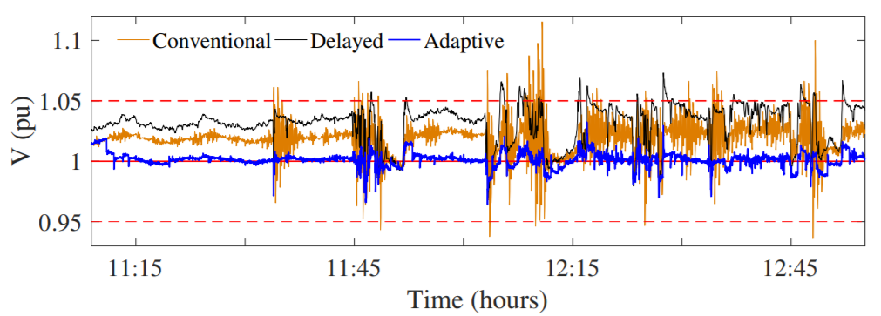
Once we have a model, what are we looking for?
Transient Events
Diurnal Cycles
Seasonal/Annual Variations
Improving Controls
(Unintended Interactions)
Population Distributions
Time-Dependent Behaviors

Slide 21
Further Information
Video Tutorials, Walkthrough, and Other Good Information
https://www.gridlabd.org/started.stm
GitHub Links
https://github.com/gridlab-d/gridlab-d
Wiki
http://gridlab-d.shoutwiki.com/wiki/Main_Page
SourceForge Forums (Help Questions)
https://sourceforge.net/p/gridlab-d/discussion
Users’ Publications
http://gridlab-d.shoutwiki.com/wiki/Publications
Contact:
Jason Fuller
jason.fuller@pnnl.gov
Frank Tuffner
francis.tuffner@pnnl.gov

